Slide 1
Biology
Sylvia S. Mader
Michael Windelspecht
Chapter 26
Flowering Plants: Control of Growth Responses
Lecture Outline
See separate FlexArt PowerPoint slides for all figures and tables pre-inserted into PowerPoint without notes.
Copyright 2022 © McGraw Hill LLC. All rights reserved. No reproduction or distribution without the prior written consent of McGraw Hill LLC.

Slide 2
Outline
26.1 Plant Hormones
26.2 Plant Growth and Movement Responses
26.3 Plant Responses to Phytochrome

Slide 3
26.1 Plant Hormones
Flowering plants perceive and react to a variety of environmental stimuli.
    Stimuli include light, gravity, carbon dioxide levels, pathogen infection, drought, and touch.
    Response to stimuli leads to the survival of the species.
The responses can be:
  Short-term
    Stomata open and close in response to light levels.
  Long-term
    The response to gravity causes downward growth of the root and the upward growth of the stem.

Slide 4
Signal Transduction
Response of plants to environmental stimuli involves signal transduction.
  The binding of a molecular “signal” that initiates and amplifies a response.
  Signal transduction involves the following:
    Receptors – Proteins activated by a specific signal
    Transduction pathway – A series of relay proteins or enzymes that amplify and transform the signal to one understood by the machinery of the cell
    Cellular response – The result of the transduction pathway

Slide 5
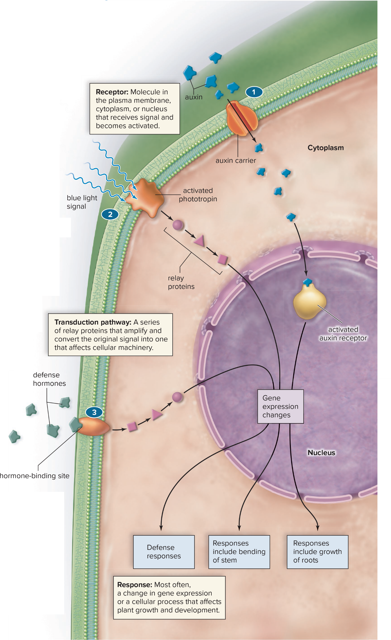
Signal Transduction in Plants
Figure 26.1
Access the text alternative for slide images.

Slide 6
Hormones
  Chemical signals that coordinate cell responses
  Enable plant cells to communicate
  Are synthesized in one part of the plant
  Travel within phloem or from cell to cell in response to the appropriate stimulus

Slide 7
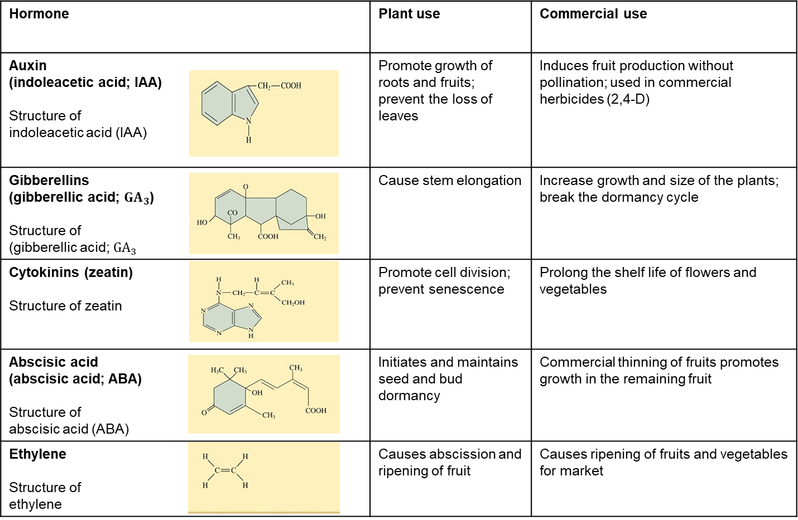
Plant Hormones
Table 26.1 Plant Hormones
Access the text alternative for slide images.

Slide 8
Auxins Affect Growth and Development
  Produced in shoot apical meristem
  Found in young leaves, flowers, and fruits
Effects of auxin on growth and development:
  Apically produced auxin prevents the growth of axillary buds.
    Apical dominance
  Promotes growth of roots and fruit
  Prevents loss of leaves and fruit
  Promotes positive phototropism of stems
8

Slide 9
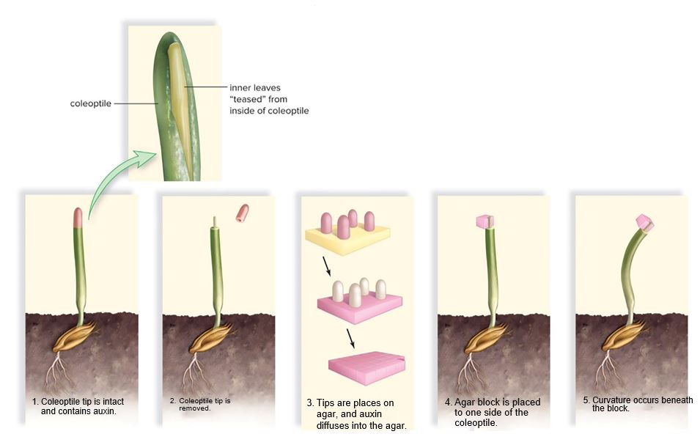
Auxin and Phototropism
Figure 26.2
Access the text alternative for slide images.
9

Slide 10
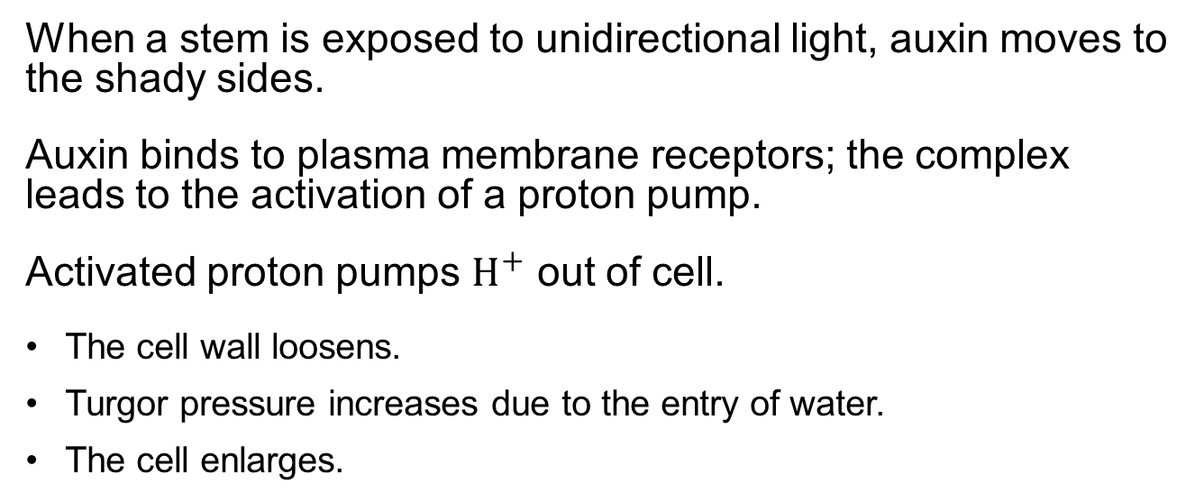
How Auxins Cause Stems to Bend
  When a stem is exposed to unidirectional light, auxin moves to the shady sides.
  Auxin binds to plasma membrane receptors; the complex leads to the activation of a proton pump.
  Activated proton pumps $H^{+}$ out of cell.
    The cell wall loosens.
    Turgor pressure increases due to the entry of water.
    The cell enlarges.
Synthetic auxins have been used as herbicides to control weeds.
Agent Orange is a synthetic auxin used to defoliate forests in Vietnam during the war.
10

Slide 11
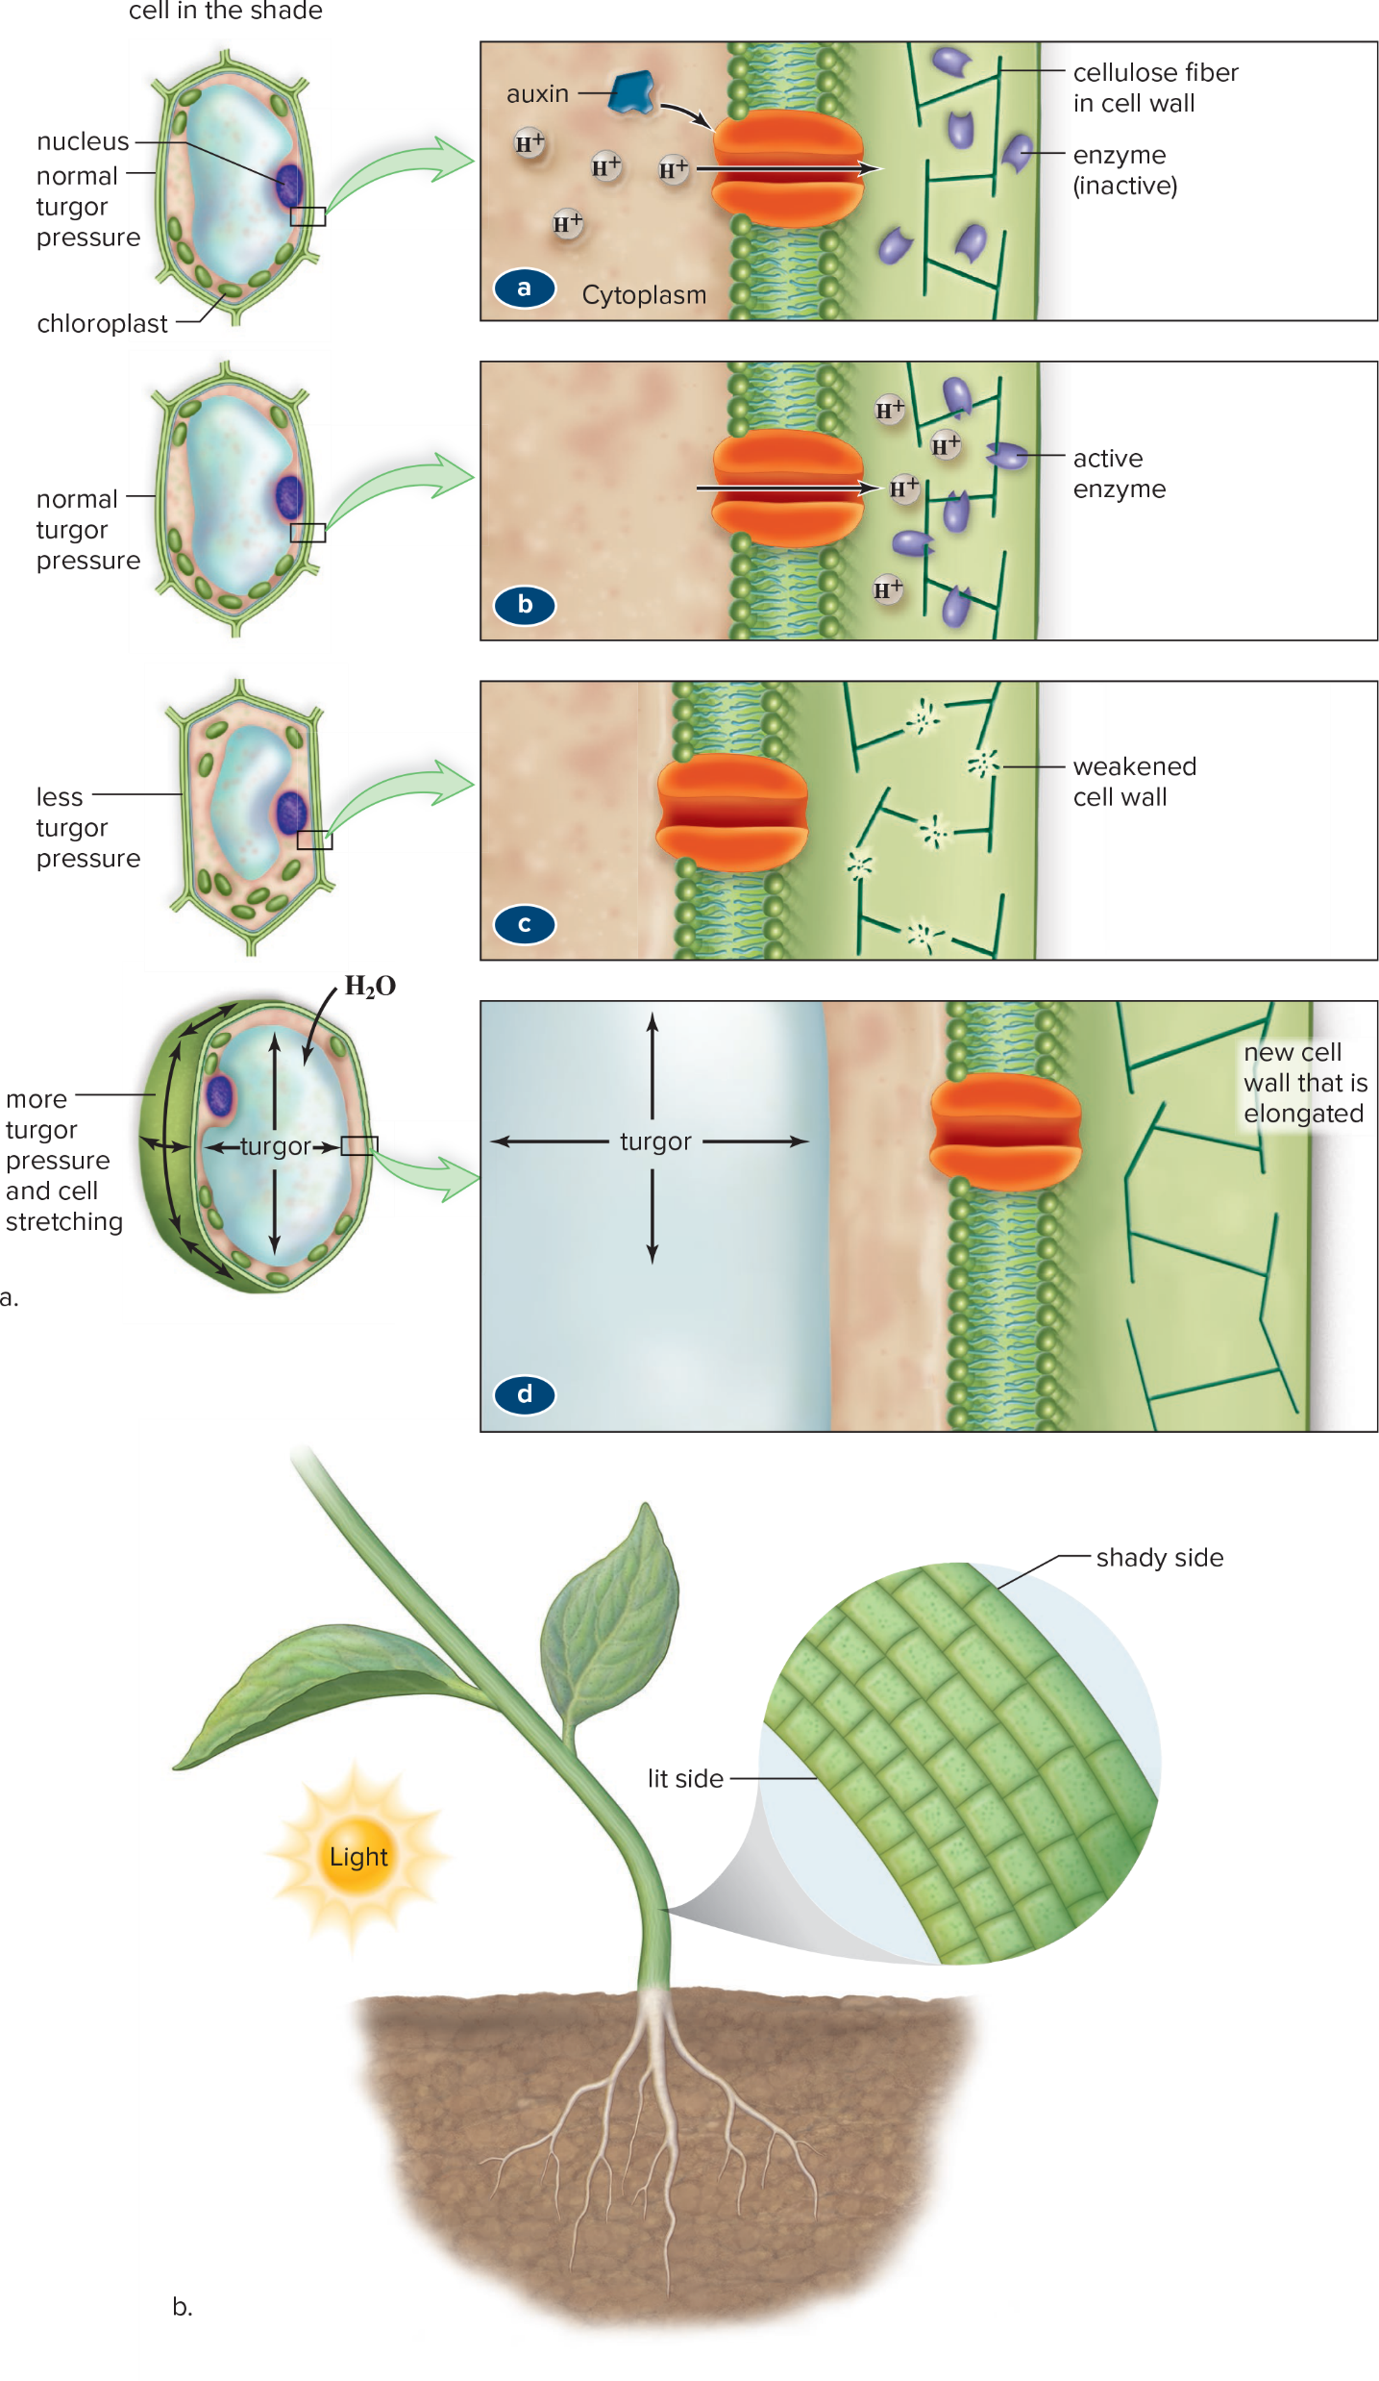
Expansion of the Cell Wall on the Shady Side of a Plant
Figure 26.3
Access the text alternative for slide images.
11

Slide 12
Gibberellins
Gibberellins are growth-promoting hormones.
  Gibberellins cause stem elongation.
  There are about 136 gibberellins.
    Each differ slightly chemically.
    The most common is gibberellic acid.
  Gibberellins are used commercially to induce growth in crops.
  Dormancy is a period of time when plant growth is suspended.
    Gibberellins can break the dormancy of buds and seeds.
12

Slide 13
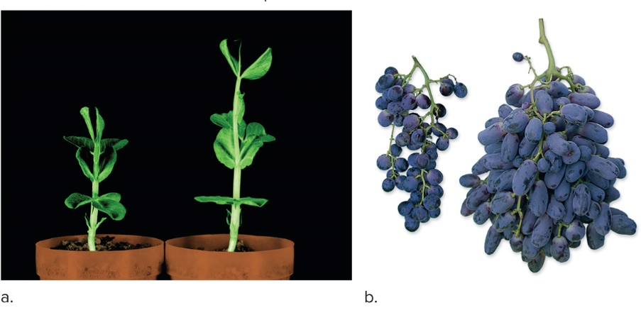
Gibberellins Cause Stem Elongation
Figure 26.4
(a): OmikronScience Source; (b): ©Amnon Lichter, The Volcani Center
13

Slide 14
Cytokinins
The cytokinins are a class of hormones that promote cell division and organ formation.
  Found in dividing tissues of roots, in seeds, and in fruits
  Responsible for root nodule formation (house nitrogen-fixing bacteria) and gall formation on wounded trees
  Have been used to prolong the life of flower cuttings as well as vegetables in storage
  Interaction between auxin and cytokinins prevent senescence (aging process).
  In autumn, low levels of cytokinins cause leaves to change color and die.
14

Slide 15
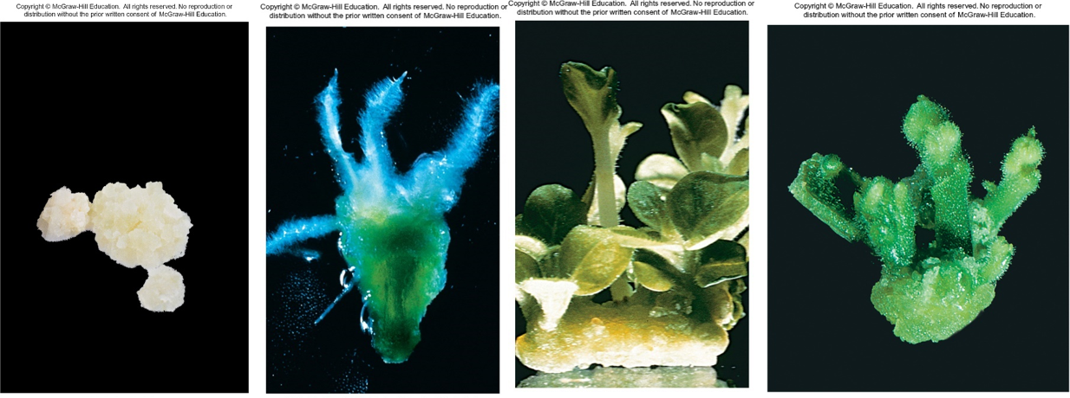
Interaction of Cytokinins and Auxins in Organ Development
Figure 26.5
(a): Biophoto Associates/Science Source; (b—d): ©Alan Darvill and Stefan Eberhard, Complex Carbohydrate Research Center, University of Georgia
15

Slide 16
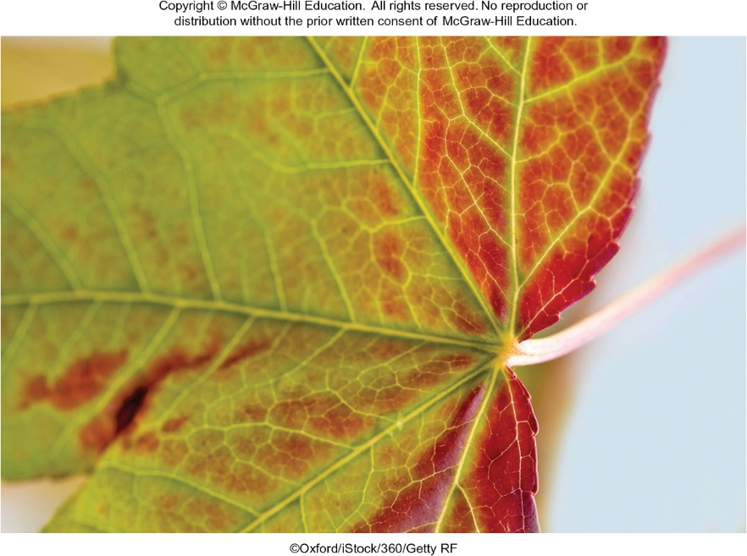
Leaves Change Color When Cytokinin Levels Are Low
Figure 26.6
Oxford/iStock/360/Getty Images
16

Slide 17
Abscisic Acid
Abscisic acid (ABA) is produced by any “green tissue” (that is tissue containing chloroplasts).
  Sometimes called the stress hormone
    It initiates and maintains seed and bud dormancy.
    It brings about the closure of stomata.
    Abscission is the dropping of leaves, fruits, and flowers from a plant.
    ABA-insensitive mutant corn show vivipary, an early break in dormancy and germination while on the cob.
17

Slide 18
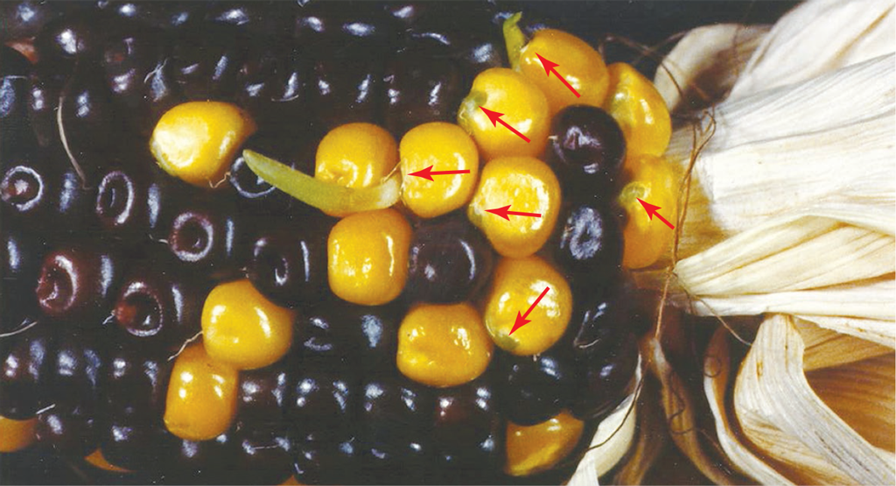
Dormancy and Germination
Figure 26.7
Dr. Donald R. McCarty, University of Florida
18

Slide 19
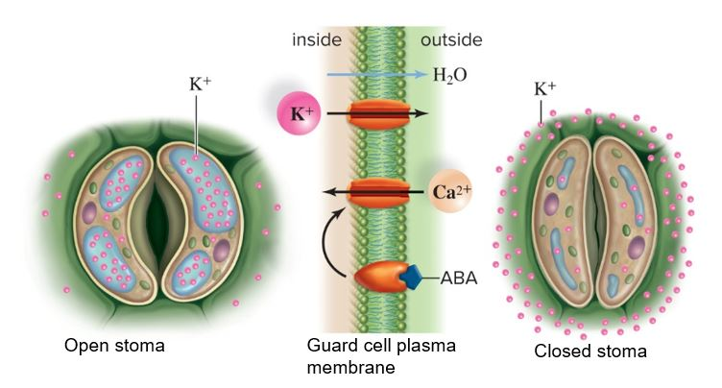
Abscisic Acid Promotes Closure of Stomata
Figure 26.8
19

Slide 20
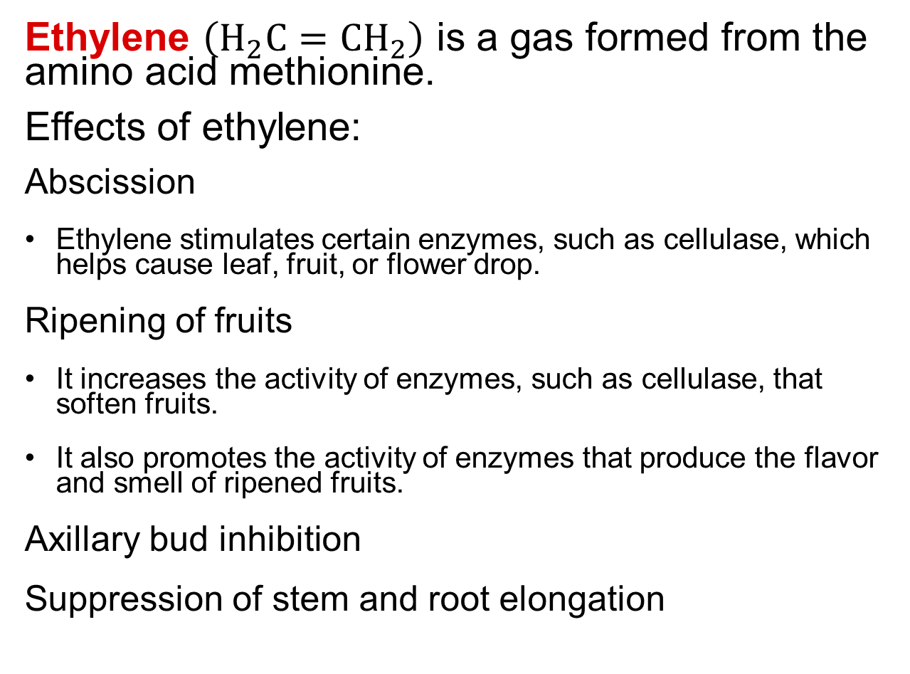
Ethylene
Ethylene $\left(H_{2}C={CH}_{2}\right)$ is a gas formed from the amino acid methionine.
Effects of ethylene:
  Abscission
    Ethylene stimulates certain enzymes, such as cellulase, which helps cause leaf, fruit, or flower drop.
  Ripening of fruits
    It increases the activity of enzymes, such as cellulase, that soften fruits.
    It also promotes the activity of enzymes that produce the flavor and smell of ripened fruits.
  Axillary bud inhibition
  Suppression of stem and root elongation
20

Slide 21
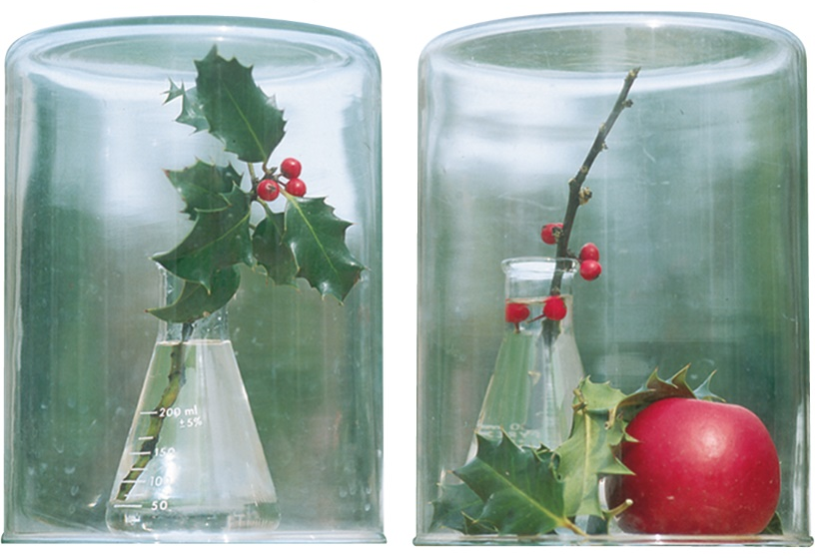
Ethylene and Abscission
No abscission
Abscission
Figure 26.9
(both): Kingsley Stern
21

Slide 22
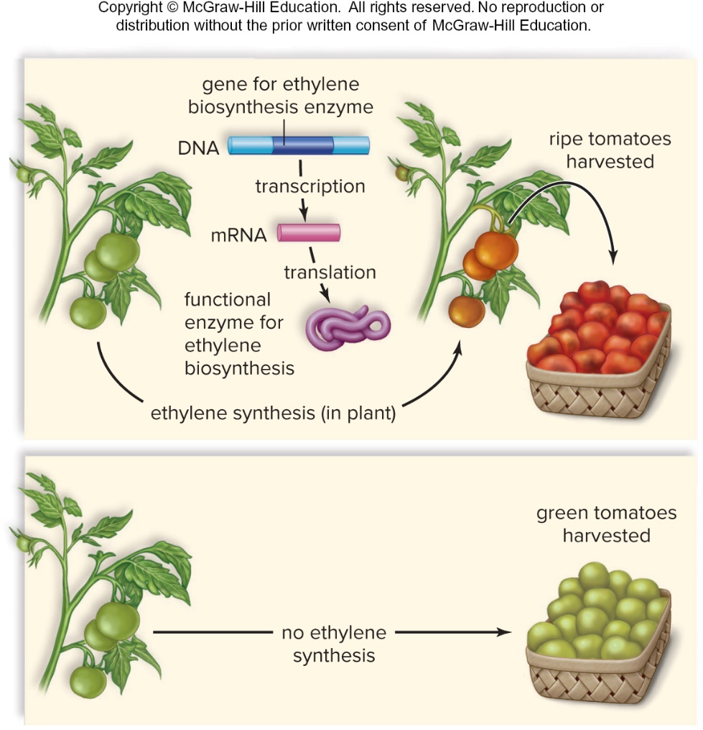
Ethylene Ripens Fruit
Figure 26.10
Access the text alternative for slide images.
22

Slide 23
Responding to the Biotic Environment
Hormones primarily play a role in how a plant responds to abiotic stimuli, such as light, oxygen, water, pH, and temperature.
Plants must produce materials and chemicals to help mitigate biotic situations such as herbivory, parasitism, and competition from other plants.
  While a plant’s epidermis and bark discourage attackers, many herbivores have ways around a plant’s first line of defense.
  The primary metabolites of plants, such as sugars and amino acids, are necessary to the normal workings of a cell.
  Plants also produce secondary metabolites as a defense or survival mechanism.
    Secondary metabolites were once thought to be waste products, but now we know they are part of a plant’s arsenal to prevent predation or discourage competition.
23

Slide 24
26.2 Plant Growth and Movement Responses
Tropism: Plant growth toward or away from a unidirectional stimulus
    Positive tropism is growth toward the stimulus.
    Negative tropism is growth away from the stimulus.
  Phototropism – Movement in response to light
  Thigmotropism – Movement in response to touch
  Gravitropism – Movement in response to gravity
24

Slide 25
Phototropism
  Positive phototropism of stems
    Cells on the shady side of stem elongate due to the presence of auxin.
    Membrane photoreceptors respond to light.
    Receptors contain pigment called phototropin absorbs blue light, initiating phototropism.
    Roots are either insensitive to light or exhibit negative phototropism.
25

Slide 26
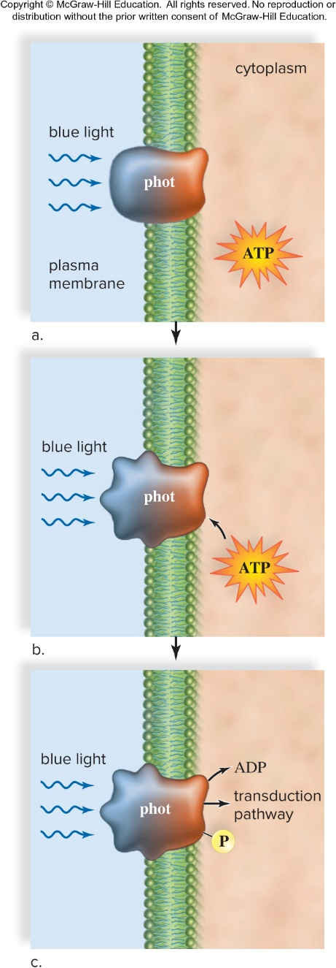
Phototropin
Figure 26.11
26

Slide 27
Thigmotropism
Response to touch from another plant, animal, rock, or wind.
  Example is coiling tendrils of stems on plants such as runner beans (Phaseolus) and morning glories.
Thigmomorphogenesis is when a plant changes overall shape due to environmental touch stimulus
  Examples: barrier, wind, rain
27

Slide 28
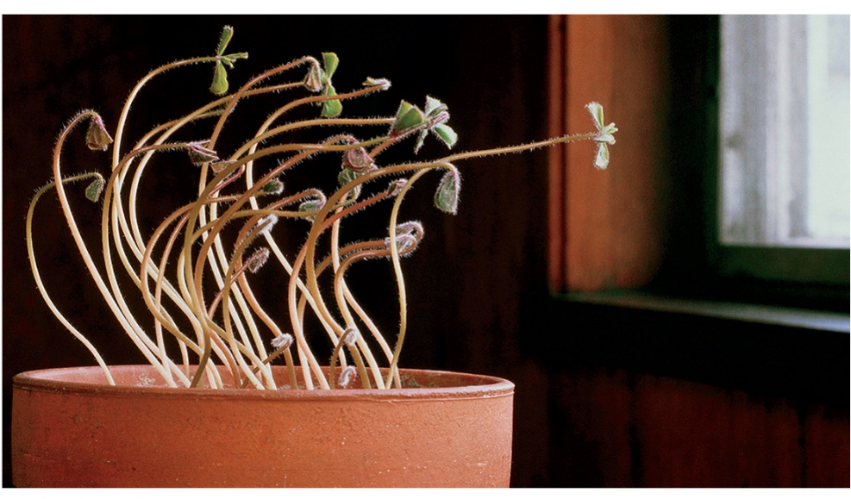
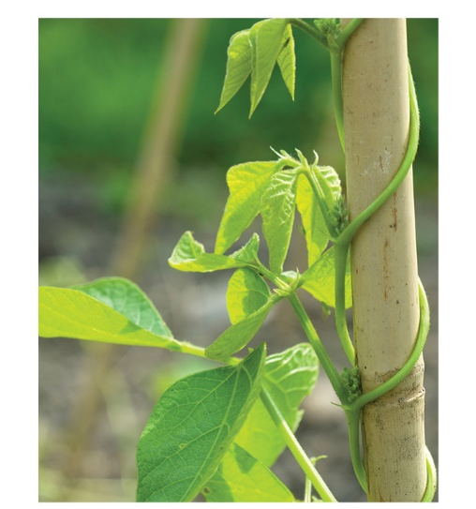
Phototropism and Thigmotropism
Phototropism
Thigmotropism
Figure 26.10
(a): Cathlyn Melloan/Stone/Getty Images; (b) Alison Thompson/Alamy Stock Photo
28

Slide 29
Gravitropism
  When a plant is placed on its side, the stem grows upward, opposite of the pull of gravity.
  Stems with root caps grow downward.
    Response depends on sensors called statoliths.
      Found in organelles called amyloplasts
      Statoliths settle to the bottom of a cell, put pressure on organelles, signaling the downward direction.
  Auxin may be responsible for gravitropism of roots and shoots.
29

Slide 30
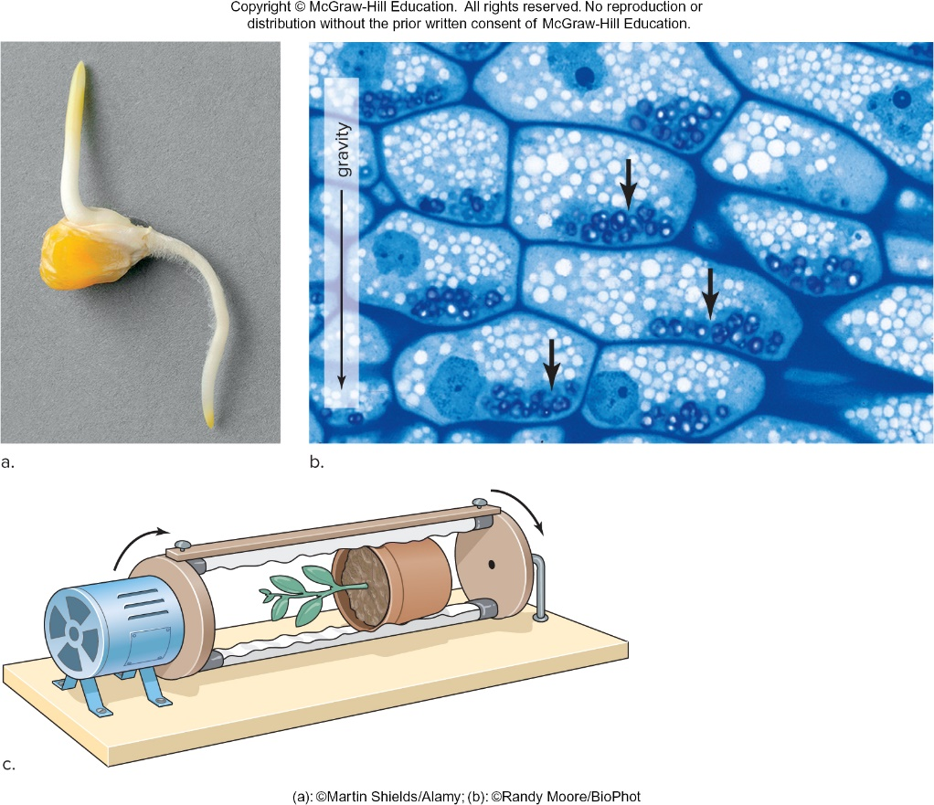
Gravitropism Examples
Figure 26.13
Access the text alternative for slide images.
(a): Martin Shields/Alamy Stock Photo; (b): Randy Moore
30

Slide 31
Why So Many Scientists
Work with Arabidopsis
Arabidopsis thaliana
  It is a small flowering plant related to cabbage and mustard plants.
  It has no commercial value.
  It has become a model organism for the study of plant molecular genetics, including signal transduction.
    It is small, so many hundreds of plants can be grown in a small amount of space.
    Generation time is short; 5 to 6 weeks until maturity.
    It normally self-pollinates, but it can easily be cross-pollinated.
    The number of base pairs in its DNA is relatively small.
31

Slide 32
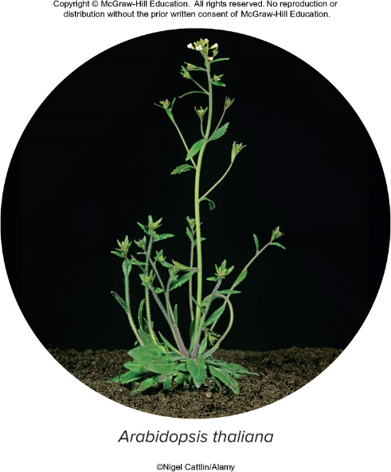
Arabidopsis thaliana
Figure 26D
Nigel Cattlin/Alamy Stock Photo
32

Slide 33
Movement Caused by
Internal Stimuli
Turgor movements also called nastic movements:
  Do not involve growth and
  Are not dependent on the stimulus direction
  Could be result of electrical impulses, hormone action, or changes in turgor pressure
Turgor movements result from touch, shaking, or thermal stimulation. Examples:
  Mimosa pudica
  Venus flytrap
Sleep movements:
  Occur daily in response to light and dark changes
    Circadian rhythm and effects of photosensitive pigments
33

Slide 34
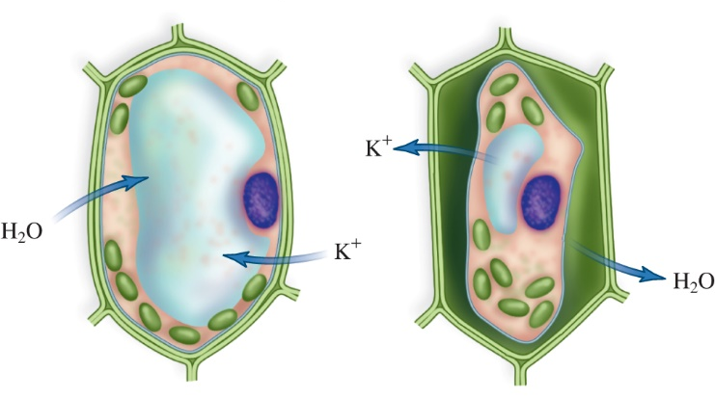
Plant Cell Exhibits Turgor
Cell is turgid
Cell is limp
34

Slide 35
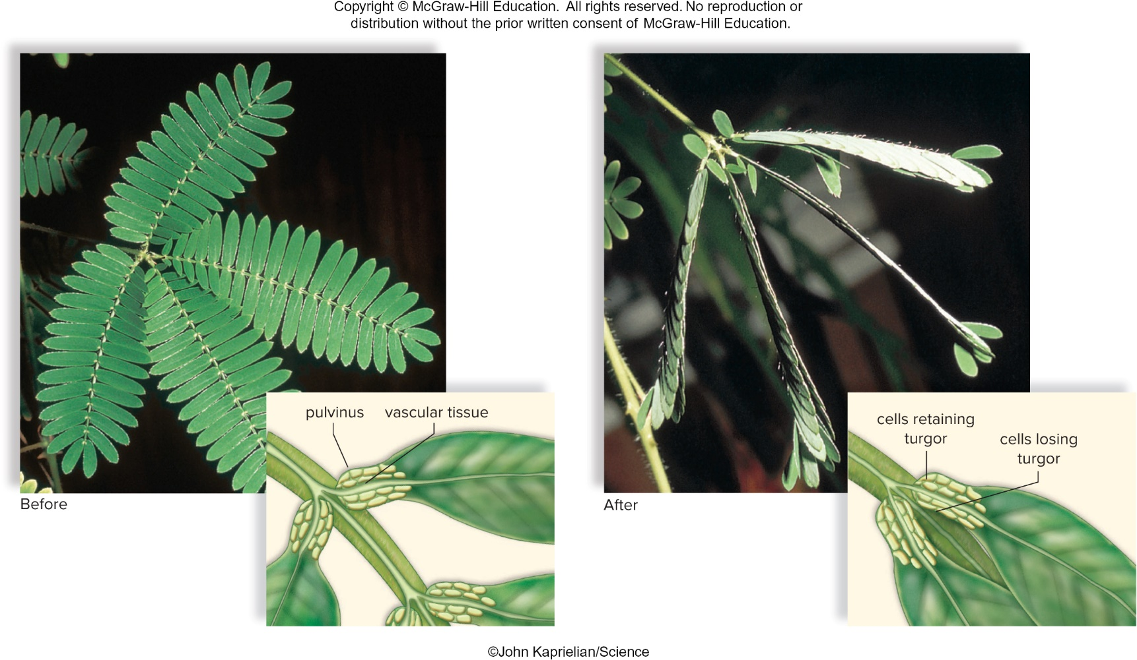
Turgor Movement
Figure 26.14
(both photos): John Kaprielian/Science
35

Slide 36
26.3 Plant Responses to Phytochrome
Photoperiodism: Any physiological response prompted by changes in day or night length
  Influences flowering in some plants
  Requires participation of a biological clock and a plant photoreceptor called phytochrome
36

Slide 37
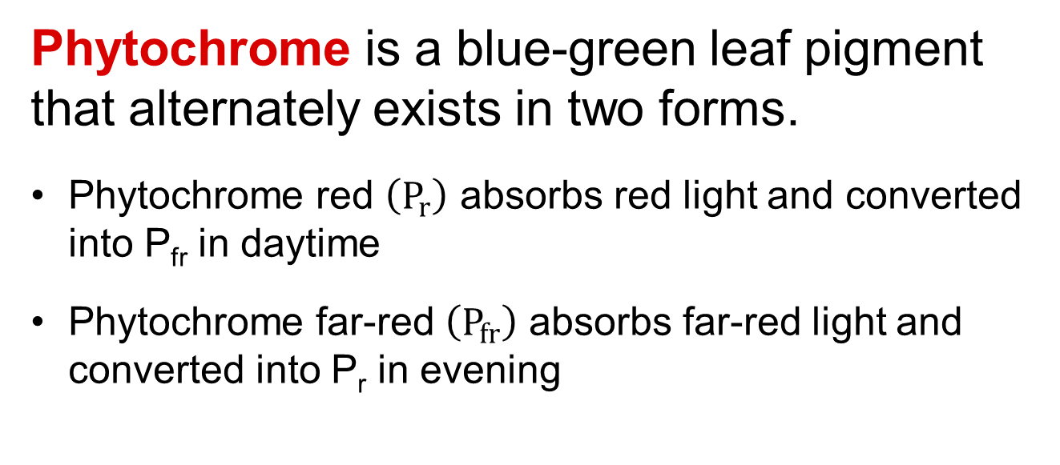
Phytochrome
Phytochrome is a blue-green leaf pigment that alternately exists in two forms.
  Phytochrome red $\left(P_{r}\right)$ absorbs red light and converted into P_{fr} in daytime
  Phytochrome far-red $\left(P_{fr}\right)$ absorbs far-red light and converted into P_{r} in evening
Conversion of forms allows a plant to detect photoperiod changes.
Also promotes seed germination and flowering and inhibits shoot elongation
37

Slide 38
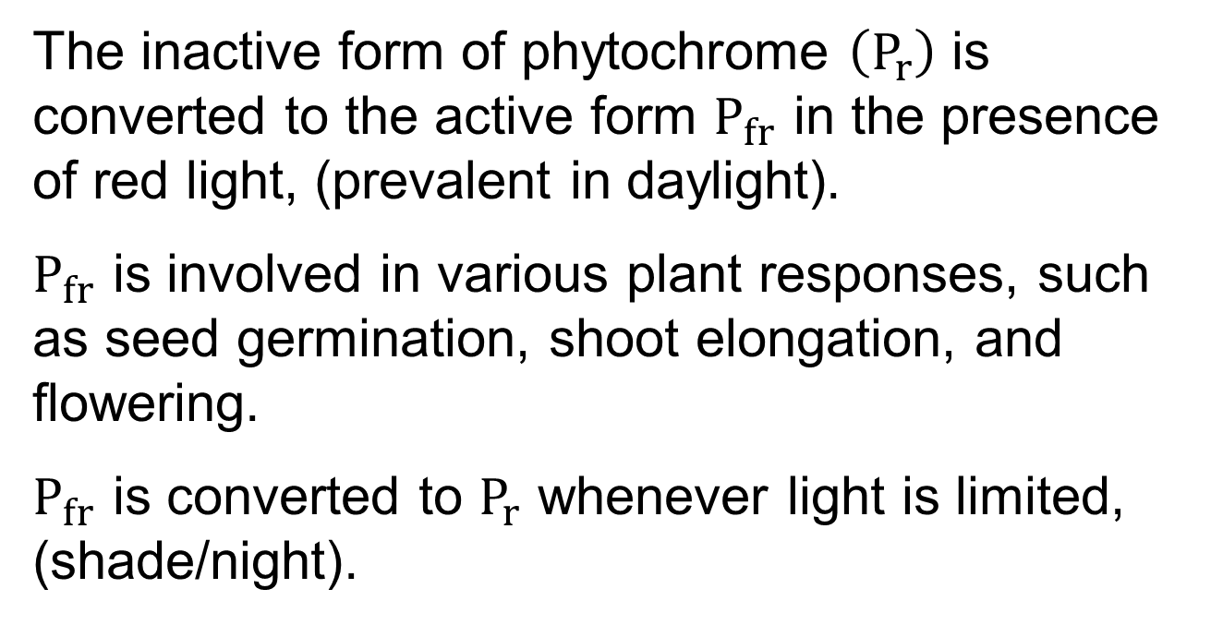
Inactive and Active Phytochrome
The inactive form of phytochrome $\left(P_{r}\right)$ is converted to the active form $P_{fr}$ in the presence of red light, (prevalent in daylight).
$P_{fr}$ is involved in various plant responses, such as seed germination, shoot elongation, and flowering.
$P_{fr}$ is converted to $P_{r}$ whenever light is limited, (shade/night).
38

Slide 39
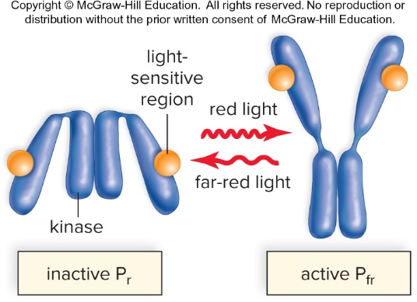
Phytochrome Conversion Cycle
Figure 26.15
Access the text alternative for slide images.
39

Slide 40
Flowering and Photoperiodism
  Requires participation of a biological clock
Physiological changes in flowering plants are related to a seasonal change in day length.
  Flowering plants can be divided into three groups, based on their flowering status.
    Short-day plants flower when the day length is shorter than a critical length.
    Long-day plants flower when the day length is longer than a critical length.
    Day-neutral plants are not dependent on day length for flowering.
  Some plants may require a specific sequence of day lengths in order to flower.
40

Slide 41
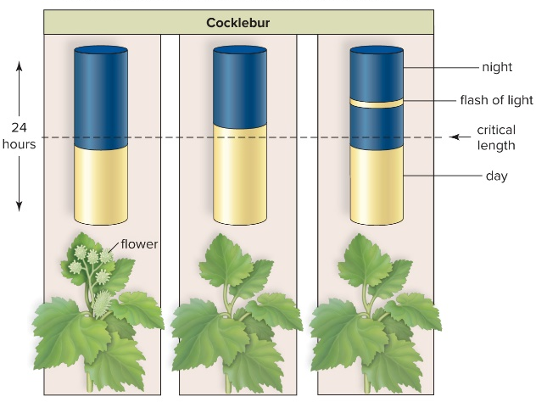
Short-Day (Long-Night) Plant
When the day is shorter than a critical length, this type of plant flowers. The plant does not flower when the day is longer than the critical length or if the longer-than-critical-length night is interrupted by a flash of light.
Figure 26.16
Access the text alternative for slide images.
41

Slide 42
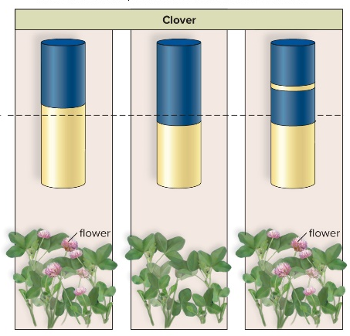
Long-Day (Short-Night) Plant
When the day is longer than a critical length this plant flowers. When the day is shorter than a critical length, this type of plant does not flower. However, it does flower if the slightly longer-than-critical-length night is interrupted by a flash of light.
Figure 26.16
42

Slide 43
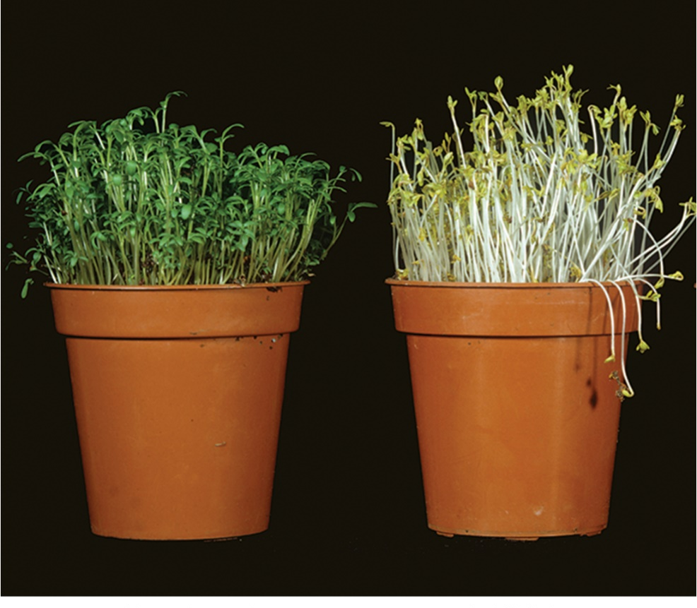
Phytochrome Controls Shoot Elongation and Chlorophyll Production
Figure 26.17
Nigel Cattlin/Alamy Stock Photo
43

Slide 44
Phytochrome and Competition
Phytochrome and plant spacing:
  Red and far red light also signal spacing.
  Leaf shading increases the amount of far-red light relative to red light.
  Plants measure the amount of far-red light bounced back by neighboring plants.
  The more far-red light (relative to red light) perceived correlates to energy spent to grow taller, which is a strategy to outcompete others for sunlight.
44

Slide 45
Circadian Rhythms
  Circadian rhythms: Biological rhythms with a 24-hour cycle
  Tend to be persistent
    Rhythm is maintained in the absence of environmental stimuli.
    Caused by a biological clock
    In plants with sleep movements, the sleep cycle changes when plant is kept in dim light
    Entrainment means to be synchronized to light at daybreak.
45

Slide 46
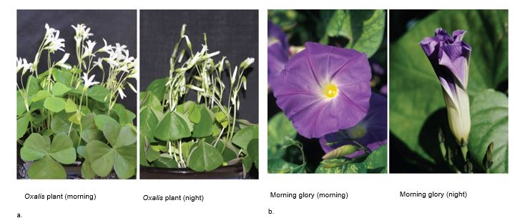
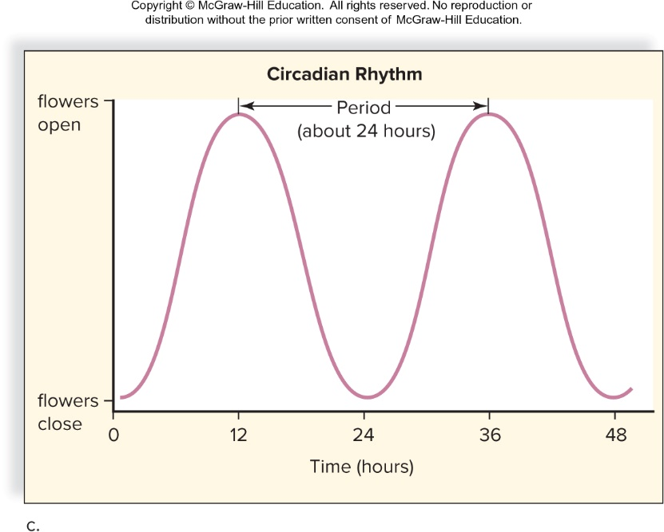
Examples of Circadian Rhythms
Figure 26.18
Access the text alternative for slide images.
(a) (both): Gretel Guest; (b) (morning): Michael Jenner/Alamy Stock Photo; (night): JupiterImages/Photos.com/360/Getty Images
46

Slide 47
End of main content
Copyright 2022 © McGraw Hill LLC. All rights reserved. No reproduction or distribution without the prior written consent of McGraw Hill LLC.

Slide 48
Accessibility Content: Text Alternatives for Images

Slide 49
Signal Transduction in Plants - Text Alternative
Return to parent-slide containing images.
The steps are given as follows:
1. Receptor: Molecules in the plasma membrane, cytoplasm, or nucleus that receives signal and becomes activated.
2. Blue light signals relay proteins.
3. Transduction pathway: A series of relay proteins that amplify and convert the original signal into one that affects cellular machinery.
4. Above steps leads to gene expression changes.
5. Results in defense responses, responses include bending of stem, and growth of roots. Most often a change in gene expression affects plant growth and development.
Return to parent-slide containing images.

Slide 50
Plant Hormones - Text Alternative
Return to parent-slide containing images.
The data for hormone with structures, plant use and commercial use is as follows:
Auxin (indoleacetic acid; IAA): Growth of roots and fruits, prevents the loss of leaves; and induces fruit production without pollination, used in commercial herbicides (2,4-D)
Gibberellins (gibberellic acid; GA3): Stem elongation and increase growth and size of the plants, breaks the dormancy cycle.
Cytokinins (zeatin): Cell division, prevents senescence; and prolong the shelf life of flowers and vegetables.
Abscisic acid (abscisic acid; ABA): Initiates and maintains seed and bud dormancy; and commercial thinning of fruits to promote growth in the remaining fruit.
Ethylene: Abscission and ripening of fruit; and ripening of fruits and vegetables for market.
Return to parent-slide containing images.

Slide 51
Auxin and Phototropism - Text Alternative
Return to parent-slide containing images.
An intact coleoptile tip contains auxin and is removed and placed on agar so that the auxin diffuses from the tip into the agar. The agar is then placed back on the seedling to one side of the coleoptile and curvature of the seedling is observed beneath the agar in response to the auxin in the agar
Return to parent-slide containing images.

Slide 52
Expansion of the Cell Wall on the Shady Side of a Plant - Text Alternative
Return to parent-slide containing images.
In a, the four phases are as follows:
1. Auxin binds to receptors.
2. Hydrogen ions are actively pumped into the cell wall area. As the pH decreases, enzymes that can break down cellulose fibers are activated in the cell wall.
3. Cellulose fibers break, loosening the wall and decreasing turgor pressure in the cell.
4. The cell expands as turgor pressure inside the cell increases, and a new, longer wall is rebuilt.
In b, the diagram of stem of a plant shows left side as lit and right as shady.
Return to parent-slide containing images.

Slide 53
Ethylene Ripens Fruit - Text Alternative
Return to parent-slide containing images.
Ethylene synthesis (in plant) results in ripe tomato harvest.
The gene for ethylene biosynthesis enzyme in DNA leads to transcription in messenger RNA which after translation leads to functional enzyme for ethylene biosynthesis.
No ethylene synthesis leads to green tomato harvest.
Return to parent-slide containing images.

Slide 54
Gravitropism Examples - Text Alternative
Return to parent-slide containing images.
a) Corn with shoot growing upward and root growing downward.
b) Micrograph shows deposition of dark colored dots at the bottom of each cell in the direction of gravity.
c) A pot of plant placed horizontally in a closed glass chamber, clinostat.
Return to parent-slide containing images.

Slide 55
Phytochrome Conversion Cycle - Text Alternative
Return to parent-slide containing images.
The inactive form of phytochrome (P_{r}) is converted to the active form P_{fr} in the presence of red light, which is prevalent in daylight. P_{fr} is involved in various plant responses, such as seed germination, shoot elongation, and flowering. P_{fr} is converted to P_{r} whenever light is limited, such as in the shade or during the night.
Return to parent-slide containing images.

Slide 56
Short-Day (Long-Night) Plant - Text Alternative
Return to parent-slide containing images.
Left panel: Leaves opened with an inset showing labels for pulvinus and vascular tissue.
Right panel: The leaves are closed after touching with an inset showing label for cells retaining turgor in pulvinus and cells at margin losing turgor.
Return to parent-slide containing images.

Slide 57
Examples of Circadian Rhythms - Text Alternative
Return to parent-slide containing images.
The horizontal axis represents time (in hours) ranges from 0 to 48 while vertical axis ranges from flower closing to flower opening.
The data is as follows:
The graph shows two consecutive parabolic curves with peak marked at 12 and 26 hours, labeled as circadian rhythm: period (about 24 hours).
Return to parent-slide containing images.

